Slide 1

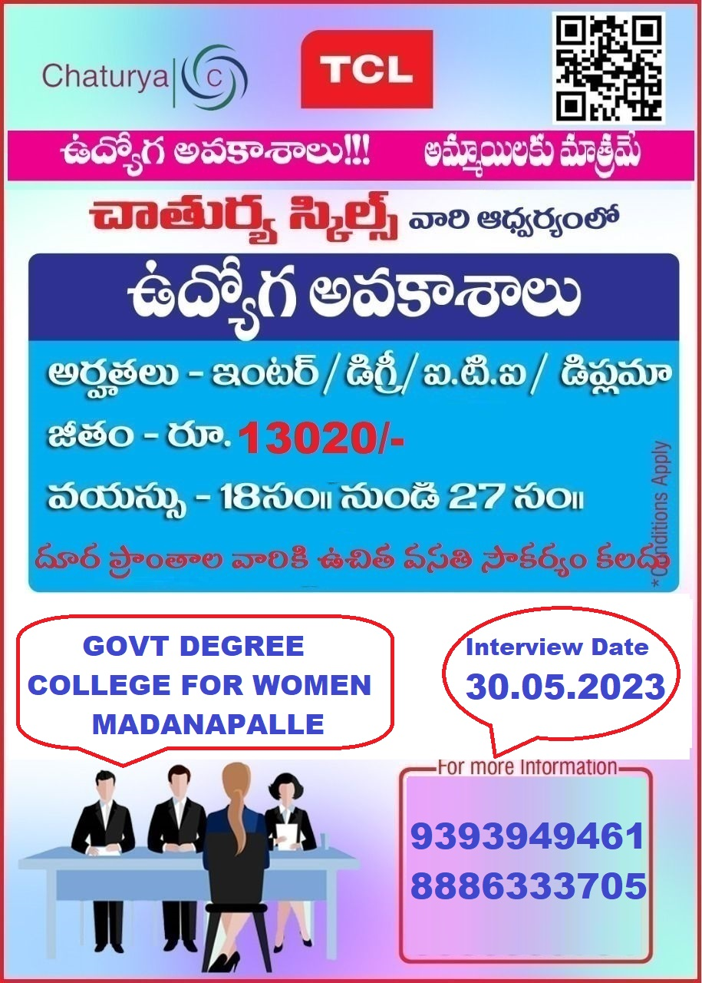
JAWAHAR KNOWLEDGE CENTRE

